Slide 1


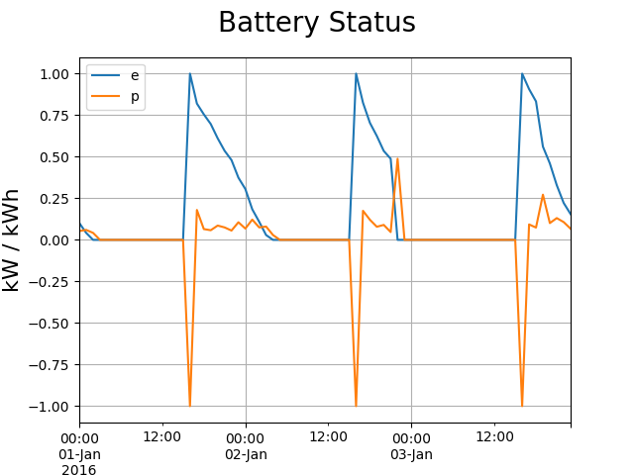
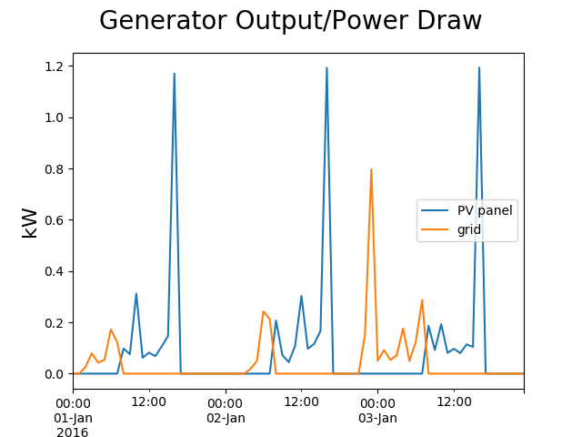
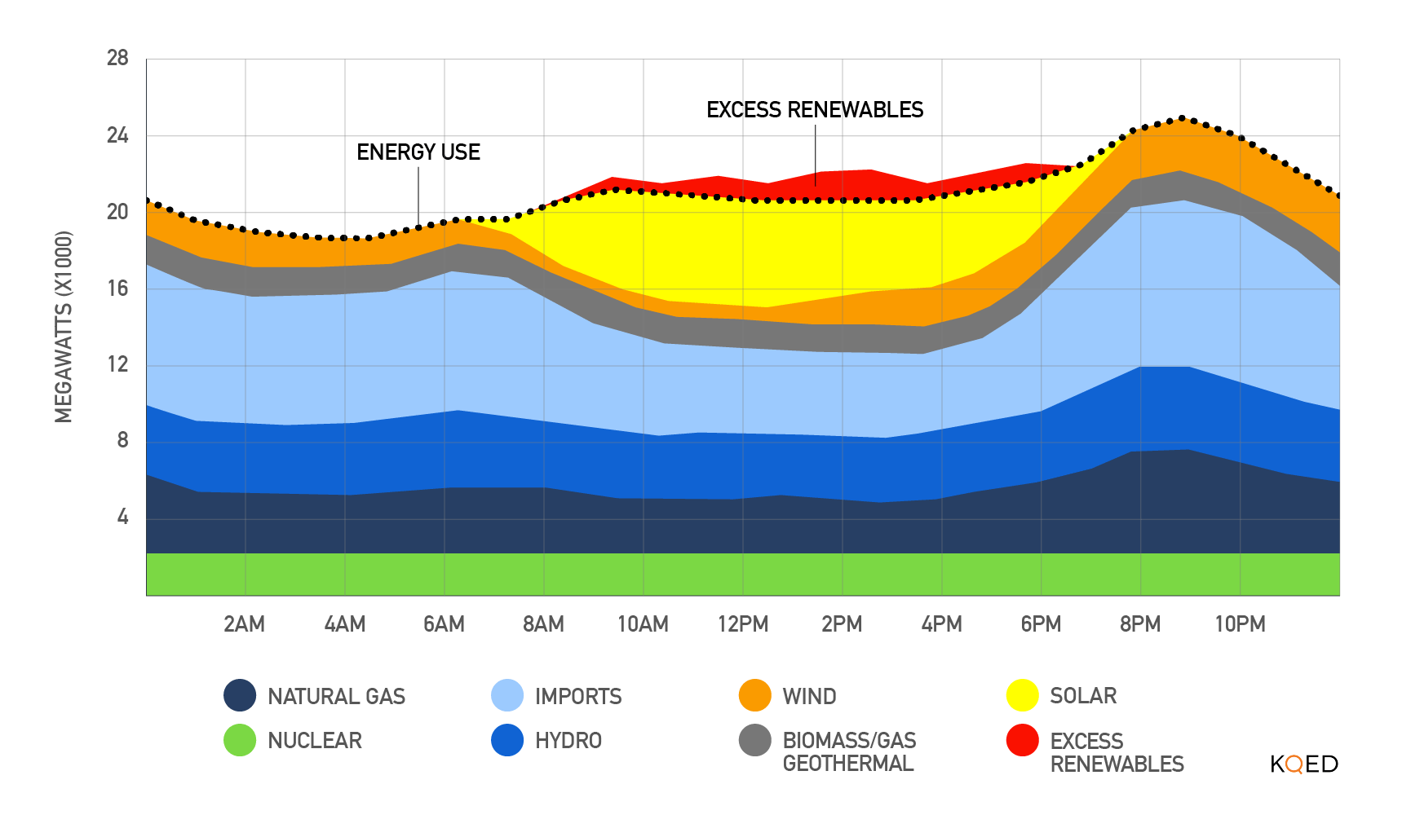
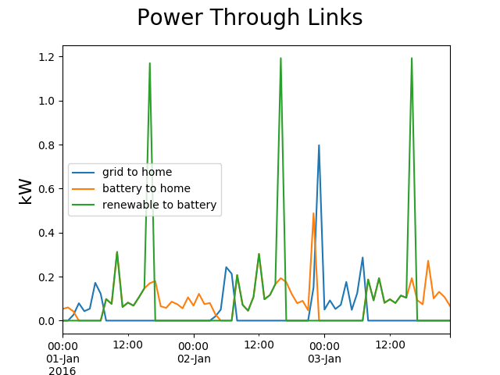
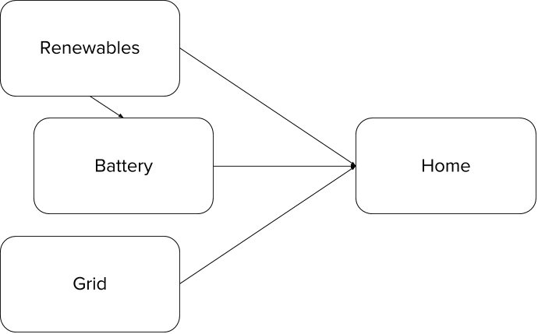
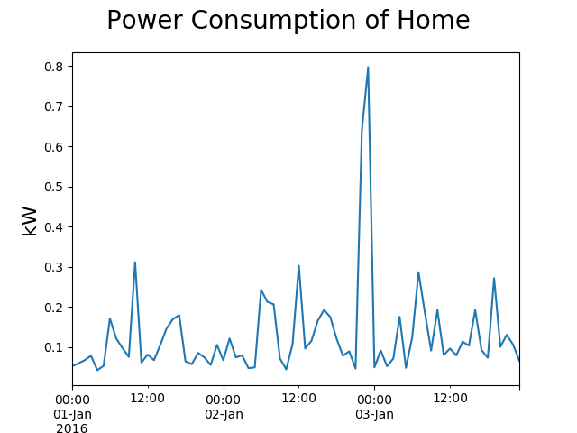
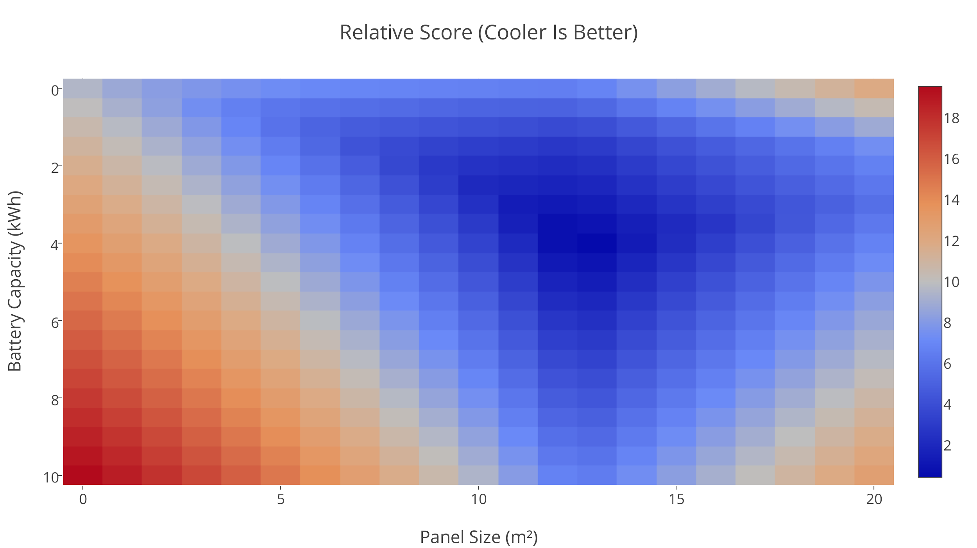
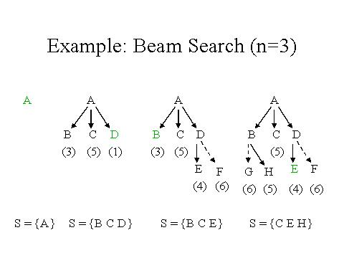
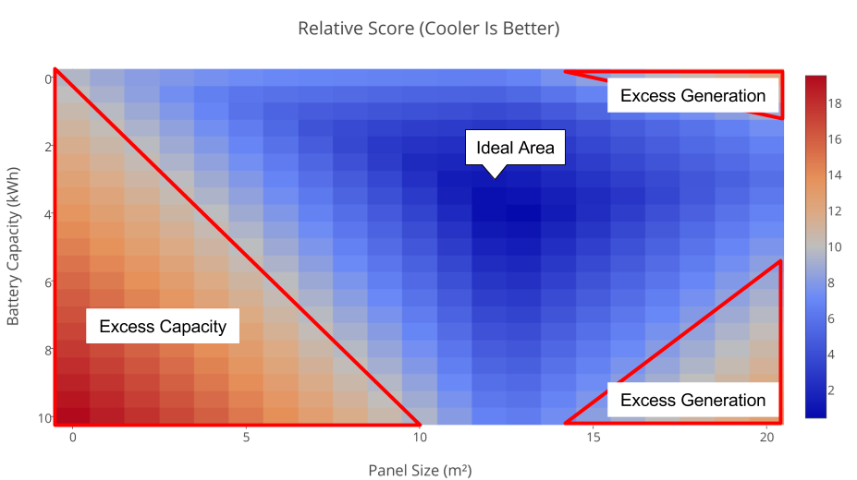
Balancing Energy Storage and Power Generation in Homes
Kevin Burgon and Nelson Miller
CS 5890 ------ Machine Intelligence in Clean Energy ----- Spring 2017
Abstract
Results
Summary
Renewable energy generation in residential areas is becoming more widespread, but much of that energy is often lost because of an inefficient balance between energy storage and energy generation. This loss can be minimized or even removed entirely while retaining cost effectiveness if the right balance is struck. A similar improvement can be made in regards to drawing power from the grid.
The best configuration found by the algorithm varied quite a bit each time the algorithm was run due to variations in solar data but in each case it converged on an optimal solution. Utilizing the simulator that is used as the evaluation function to the beam search algorithm, the following graphs can be generated using 2.0 square meters of PV panel and a battery with unlimited capacity.
In this study, we have explored the viability of the system for identifying an ideal combination of renewable power generation and energy storage for a given power curve and solar radiation. The system successfully found an optimal mix of the two, resulting in a lower cost, less wasted power, and less power drawn from the grid.
Problem Description
Conclusion
With renewable power sources in residential areas, there is an inherent mismatch with when renewables generate power and when power is needed. A solution to this is storing energy. With a renewables and energy storage system, there is an inherent problem: balancing the two. Too much energy storage is not cost effective, and too little means that there will be times when extra power is generated and not stored. Similarly, there is a theoretical limit to how much of both one would need, as eventually the system would generate more power than was ever required.
For this study, the following network was considered:
This study provides support to the viable usage of this system to identify ideal combinations of renewable power generation and energy storage, as it successfully found an optimal combination. This success, while useful in and of itself, has the potential for applicability in other scenarios as well. The network shown in the Problem Description could easily be expanded to include more renewables, more energy stores, and more loads. Conceivably, this could be expanded to the point that it reaches grid scale. Such a grid scale system could be adapted to let end consumers and residents own the power generation, with the grid providing energy storage and backup power generation.
Over time, the battery is charged by the pv panel, but the loads draw more than the capacity of the battery before the end of each day. Power is then drawn from the grid.
During the day, power is drawn from the pv panels. At night, the battery is used and residual power is drawn from the grid. The areas where the power draw is zero is where power is pulled from the battery.
Computational Study
In this study, a base network was set up with the structure as shown in the Problem Description. The configurations for the beam search algorithm consisted of the various potential combinations that can be had with a set of photovoltaic panels and a battery; this combinations were formed by a particular amount of maximum power generation through said PV panels and the capacity of the battery. When the resulting networks were evaluated, the resulting outputs consist of the power drawn from the grid, energy wasted (generated by the PV panels, but not used or stored), and excess capacity in the battery. The study utilized a preset of home loads and a PV power curve defined by solar radiation data scraped from NOAA.
Power use in California on March 27th, 2016 (Source: California ISO. (Teodros Hailye/KQED))
This network was constructed with PyPSA (Python for Power System Analysis), which is a Python package designed to simulate and optimize power systems with a variety of different variables, many of which are not used in this study.
This graph shows that the pv panel can only charge a battery so much before solar radiation decreases and the battery is left alone. The grid is used for about 4-6 hours each day.
Looking at various configurations, general trends can be seen. In the following heatmap, a cooler color can be construed to result in less waste of energy and less excess battery capacity.
Method
This heatmap shows that there is a point where the system converges to a minimum. This point, (13 kWh of battery and 13 m² of photovoltaic panels) results in the lowest score. At this point, the system has minimized the amount of power being pulled from the grid, excess capacity, and excess power generation.
This study uses beam search, which is a best first search method, similar to a hill climbing method that keeps a population of the best solutions from each generation. The implementation in this study has elements of a genetic algorithm in the creation of each subsequent generation regarding the randomness that is introduced into each new member of the population. In short, the system generates a set of random initial solutions and then ranks them on how well they did using the evaluation function, which utilizes a Newton-Raphson linear optimization algorithm. A selection of the best performing algorithms is kept as the seeds for a new population, which then goes through the same process until it converges on an optimal solution.
References
In this annotated version of the heatmap, we can see that there are general areas that can be associated with various criteria, such as the bottom left having an excess battery capacity, which would be an extraneous cost.
F.I. for Advanced Studies, 2015. PyPSA: Python for Power System
Analysis, available at: http://http://pypsa.org/.
Weather Forecast Data Loaded Live From the National Weather Service, a
Part of the National Oceanic and Atmospheric Administration. J. Kelly and W. Knottenbelt, “The UK-DALE dataset, domestic
appliance-level electricity demand and whole-house demand from five
UK homes,” Scientific Data, vol. 2, p. 150007, 2015.
(Source: J. Lehman, Intro to Computation and AI. available at: http://www.cs.cmu.edu/afs/cs.cmu.edu/academic/class/46927-f97/slides/Lec3/sld023.htm)

